Slide 1
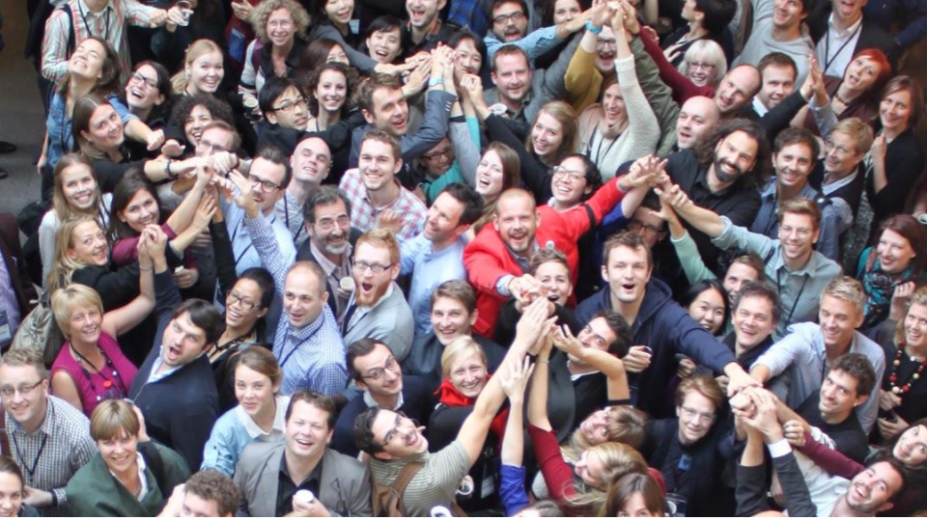

@SDNetwork
www.service-design-network.org

Slide 2


^{What is Service Design?}
“Service Design is a collaborative process of researching, envisaging, and then orchestrating experiences that happen over time and multiple touchpoints.”
Prof. Birgit Mager, SDN President
@SDNetwork
www.service-design-network.org

Slide 3
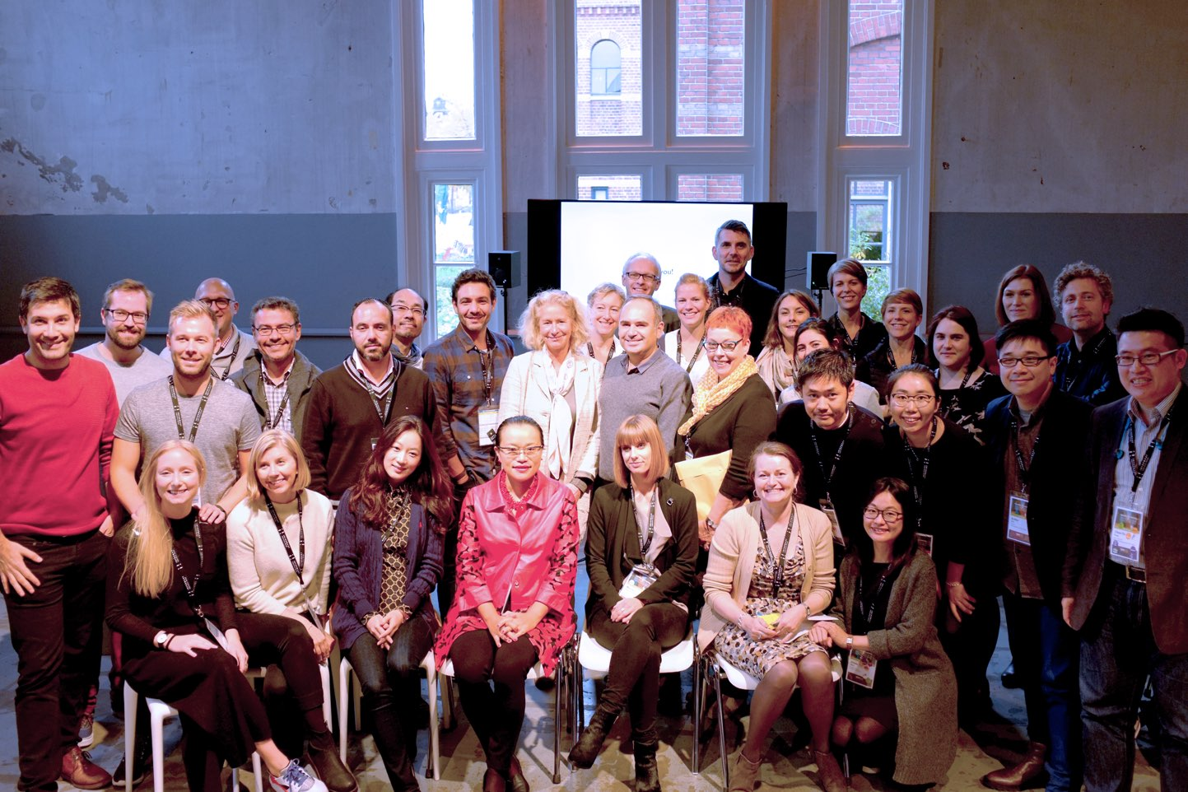
Who are we?
@SDNetwork
www.service-design-network.org

Slide 4




Volunteer-led,
non-profit organisation
29 international chapters
1,200+ members with over 10 years of expertise
70,000+ online followers
700+ SDGC attendees
We promote service design because we passionately believe it is the key to future success in a social and economical sense.
@SDNetwork
www.service-design-network.org

Slide 5








MANAGEMENT BOARD
Tarja Chydenius
Service Design Network
Laurea University Of
Applied Sciences
Shelley Evenson
Service Design Network
Fjord
Jesse Grimes
Service Design Network
Informaat
Jamin Hageman
Service Design Network
Capital One
Yigit Kulabas
Service Design Network
RE / Design Business
Birgit Mager
Service Design Network
SDN President & KISD
Alex Nisbett
Service Design Network
Designit
Brian Gillespie
Service Design Network
Independant Consultant

Slide 6








SDN GLOBAL TEAM
Karin Henz
Accountant
Cristine Lanzoni
Website, Accreditation and Publications Manager
Eloise Smith-Foster
National Chapters, Award and Member Experience Manager
Samuel Simon
Digital Media Manager
Alicia Shao
Member Care and Service Design Award Manager
Laura Gedatus
Project Manager
Katja Trinkwalder
Service Design Award Annual Publication Manager
Marie Kopka
Personal Assistant to
SDN President

Slide 7

What do we do?
@SDNetwork
www.service-design-network.org
Notes:
Change the background

Slide 8


We connect you with
like-minded, passionate professionals and service designers from companies, agencies and academia.
We equip you to create better services and raise awareness about service design.
@SDNetwork
www.service-design-network.org

Slide 9




Facilitate knowledge exchange
Create relevant content
Recognise & celebrate
best practice
Raise awareness
& grow service design
Connect the
international community
Enrich the local
SD community
@SDNetwork
www.service-design-network.org

Slide 10
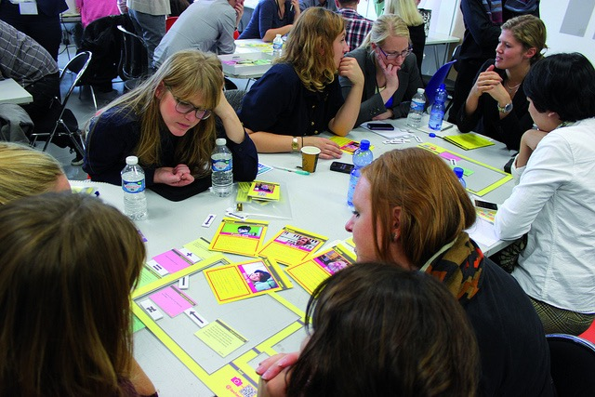
How do we do that?
@SDNetwork
www.service-design-network.org
Notes:
Change the background

Slide 11



Great conference & events discounts
^{Become a paying MEMBER for}
^{EXCLUSIVE BENEFITS}
Case study
library
Participate in exclusive
Members Day events
Touchpoint
Journal
Publish your
profile on SDN site
Podcasts &
community knowledge
@SDNetwork
www.service-design-network.org

Slide 12

Receive our Insider newsletter
^{Join our community}
^{for free as a}
^{COMMUNITY FOLLOWER}
Limited access to Touchpoint Journal
Your profile on
SDN website
Podcasts &
community knowledge
@SDNetwork
www.service-design-network.org

Slide 13
^{ONLINE COMMUNITY}
72,212
TOTAL audience following our
social media activities

Slide 14

NEW SDN COMMUNITY SLACK
Join the international conversation!
For SDN Community Followers and Members
sdn-community.slack.com

Slide 15

@SDNetwork
www.service-design-network.org

Slide 16

^{National Conferences}
Run by local chapters
Educate and explore key themes
Aimed at local and national community
@SDNetwork
www.service-design-network.org

Slide 17


Slide 18

http://bit.ly/2BXu7zh

Slide 19





^{LOCAL CHAPTER EVENTS}

Slide 20

^{Service Design Day}
^{June 1st each year}
Celebrates the field of service design
Raises awareness in new audiences
Brings the community together
@SDNetwork #ServiceDesignDay
@SDNetwork
www.service-design-network.org
www.service-design-network.org
Notes:
Changed the position of the sentences
The more members we have the bigger will be the impact.

Slide 21

^{Service Design Award}
Celebrates and rewards success
Evidences the value of service design
Showcases best practices
@SDNetwork
www.service-design-network.org

Slide 22

Service Design Award Annual 2017
Showcases best practices
Shows impact of service design
Inspires, educates & celebrates

Slide 23
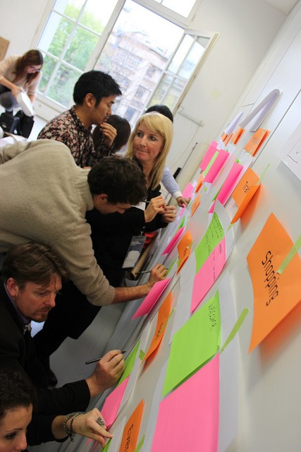
^{SDN Accredited}
^{Training Initiative}
Establish yourself as SDN Accredited Service Design Trainer
Official accreditation from the Service Design Network
Help create transparency within the industry.
@SDNetwork
www.service-design-network.org

Slide 24



^{Publications and Reports}
Touchpoint Journal
Impact Reports
Financial Sector
Public Sector
Health Sector
Design Thinking In-house
@SDNetwork
www.service-design-network.org

Slide 25
@SDNetwork
www.service-design-network.org

